Slide 1


Every Oil Well Tells A Story II

Slide 2
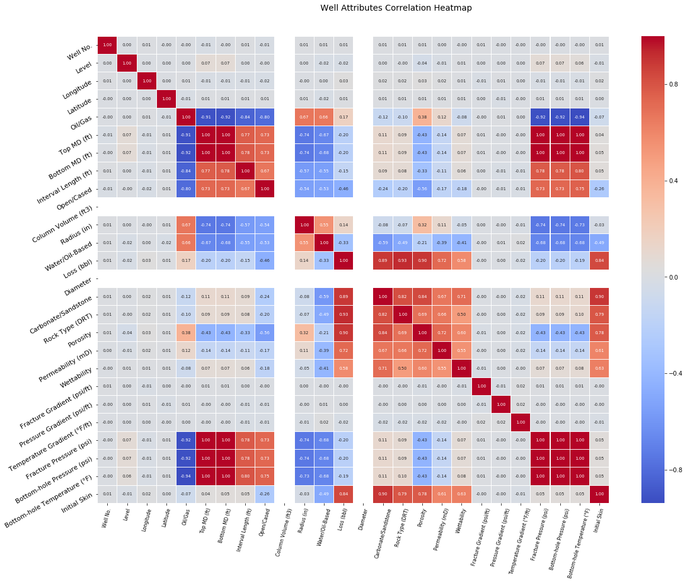

Slide 3
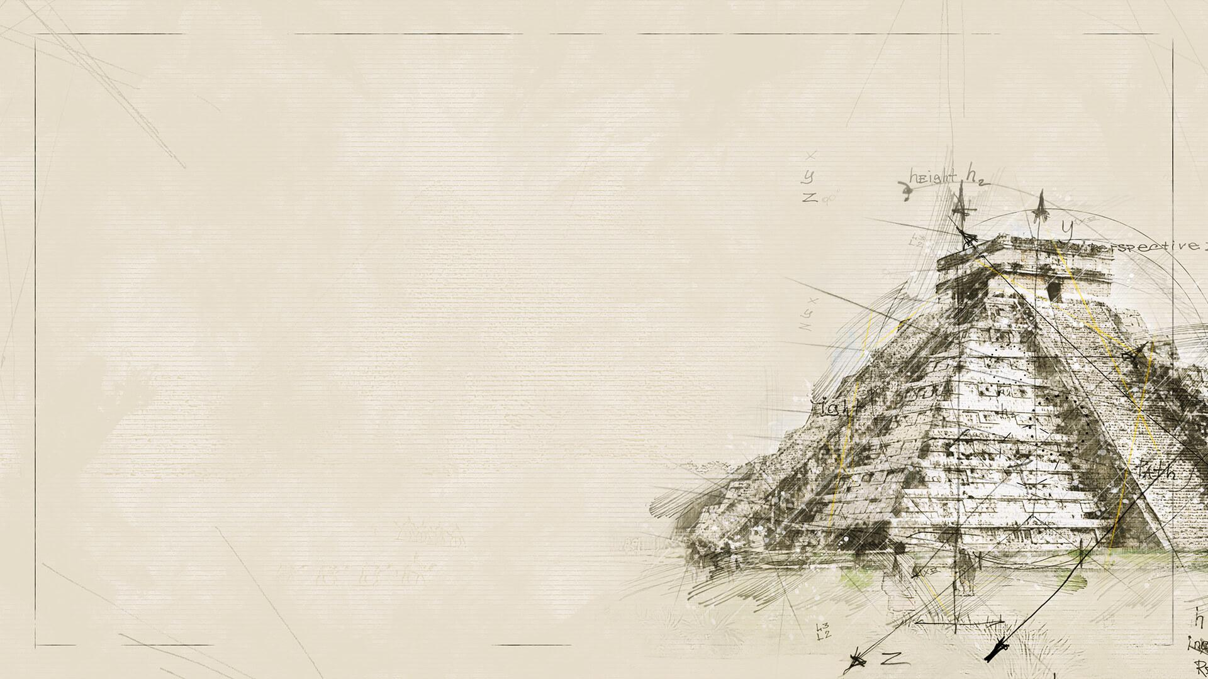
Visualization gives you answers to questions you didn’t know you had.

Slide 4
1.
Location-based Visualization
Let’s start with the first step of analysis

Slide 5
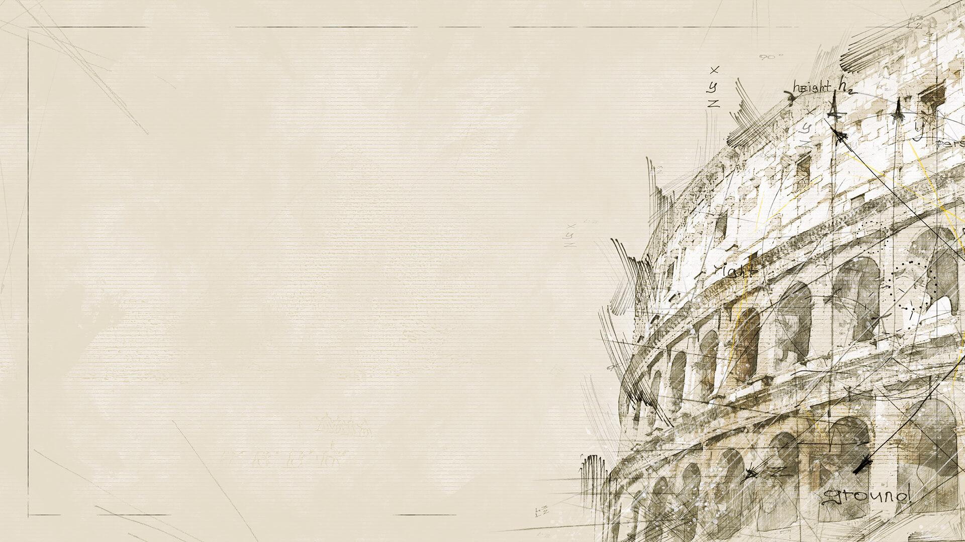
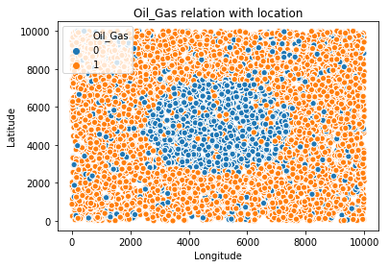
Notes:
0 -> Gas
1 -> Oil

Slide 6
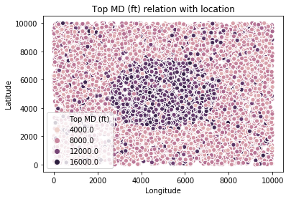

Slide 7
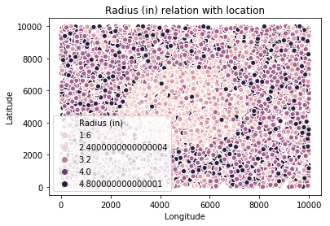

Slide 8
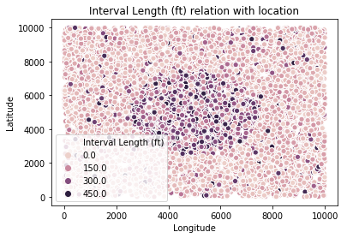

Slide 9
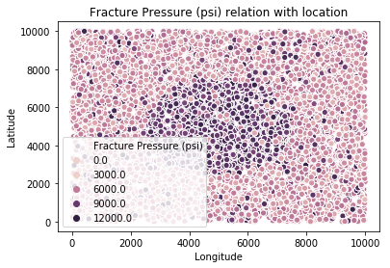

Slide 10
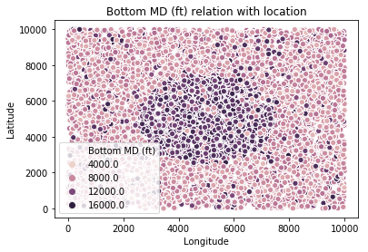

Slide 11
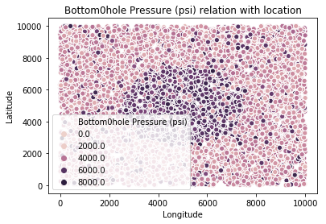

Slide 12
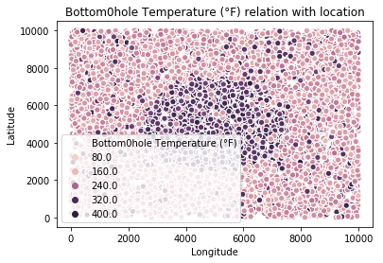

Slide 13


Slide 14
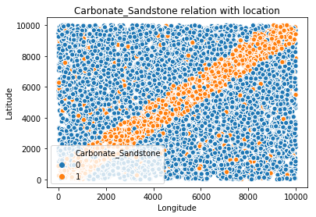
Notes:
Carbonate -> 0
Sandstone -> 1

Slide 15
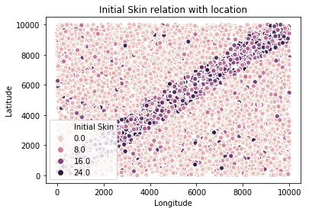

Slide 16
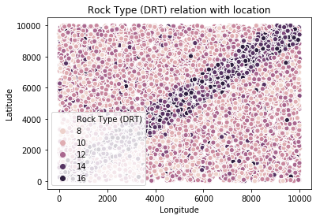

Slide 17
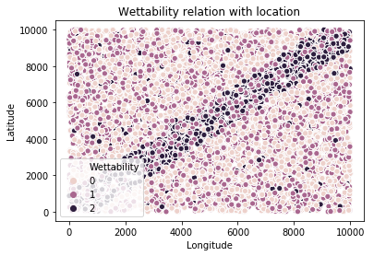

Slide 18
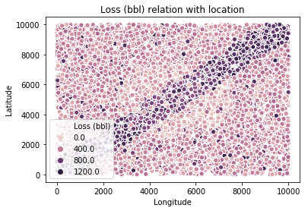

Slide 20
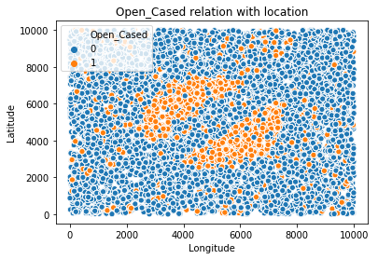
Notes:
0 -> Cased
1 -> Open

Slide 21
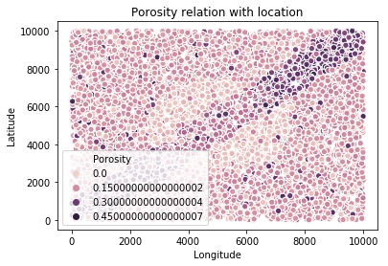

Slide 22
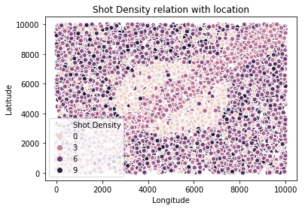

Slide 23
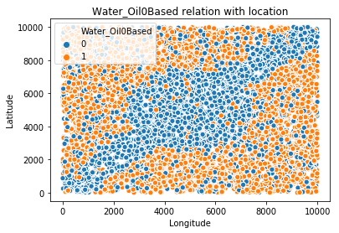
Notes:
0 -> Oil-based
1 -> Water-based

Slide 24

Features
3
2
1

Slide 25
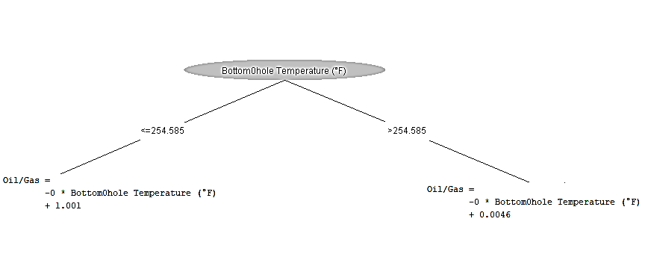
Label: Oil/Gas

Slide 26
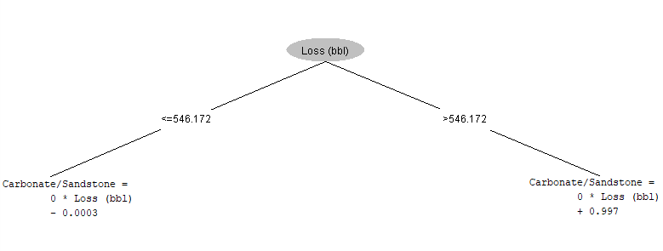
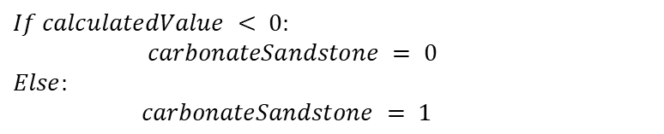
Label: Carbonate/Sandstone
$$If calculatedValue < 0:$$
$carbonateSandstone = 0$
$$Else:$$
$carbonateSandstone = 1$

Slide 27
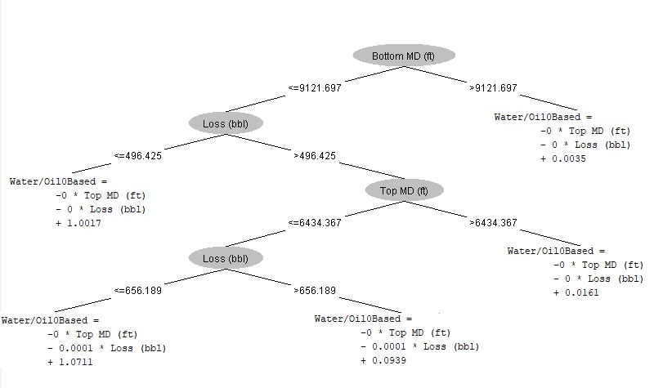
Label: Water/Oil-based

Slide 28
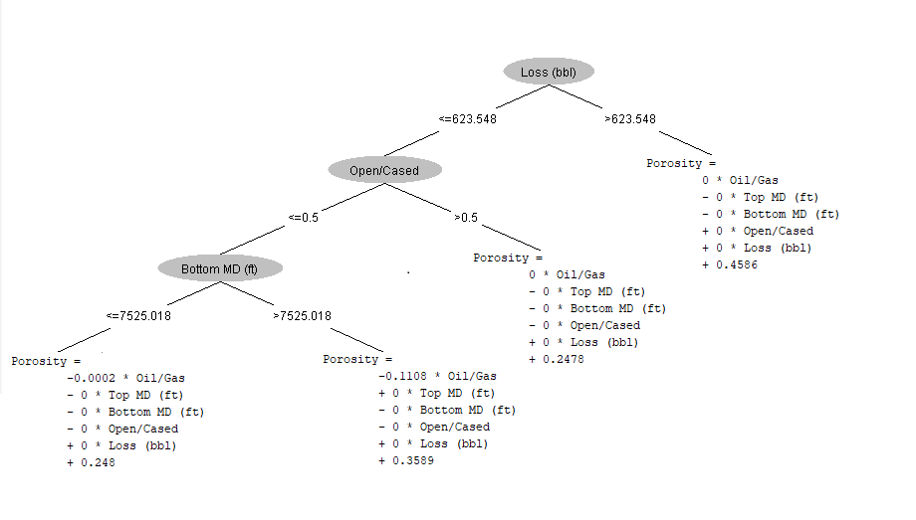
Label: Porosity

Slide 29
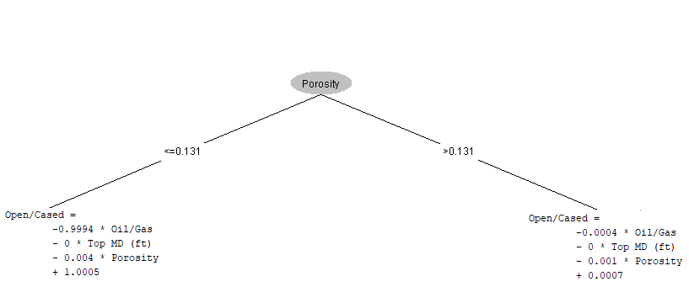
Label: Open/Cased

Slide 30
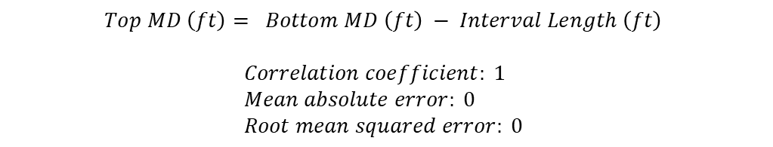
Label: Top MD (ft):
$$Top MD \left(ft\right)= Bottom MD \left(ft\right) − Interval Length \left(ft\right)$$
$$Correlation coefficient: 1 \\ Mean absolute error: 0 \\ Root mean squared error: 0$$

Slide 31
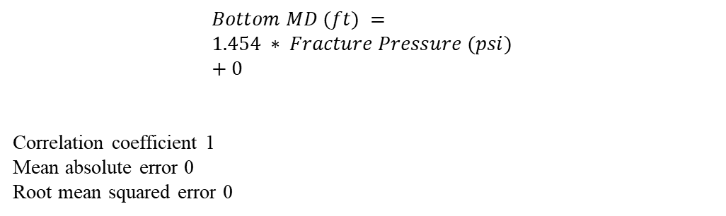
Label: Bottom MD (ft):
$$Bottom MD (ft) = \\ 1.454 ∗ Fracture Pressure (psi) \\ + 0$$
Correlation coefficient 1 Mean absolute error 0 Root mean squared error 0

Slide 32
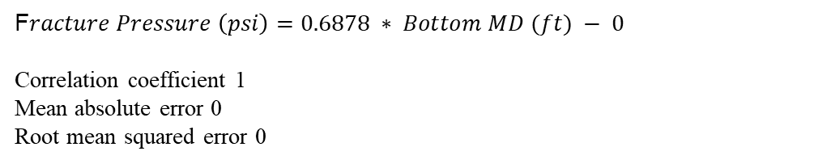
Label: Fracture Pressure:
F$racture Pressure \left(psi\right)=0.6878 ∗ Bottom MD (ft) − 0$
Correlation coefficient 1 Mean absolute error 0 Root mean squared error 0

Slide 33
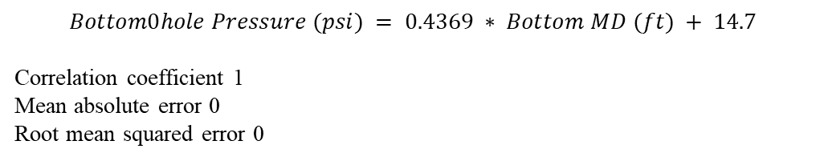
Label: Bottom Hole Pressure:
$$Bottom0hole Pressure (psi) = 0.4369 ∗ Bottom MD (ft) + 14.7$$
Correlation coefficient 1 Mean absolute error 0 Root mean squared error 0

Slide 34
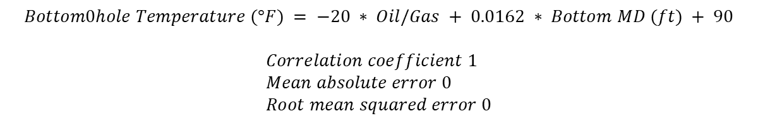
Label: Bottom Hole Temperature:
$$Bottom0hole Temperature (°F) = −20 ∗ Oil/Gas + 0.0162 ∗ Bottom MD (ft) + 90$$
$$Correlation coefficient 1 \\ Mean absolute error 0 \\ Root mean squared error 0$$

Slide 35
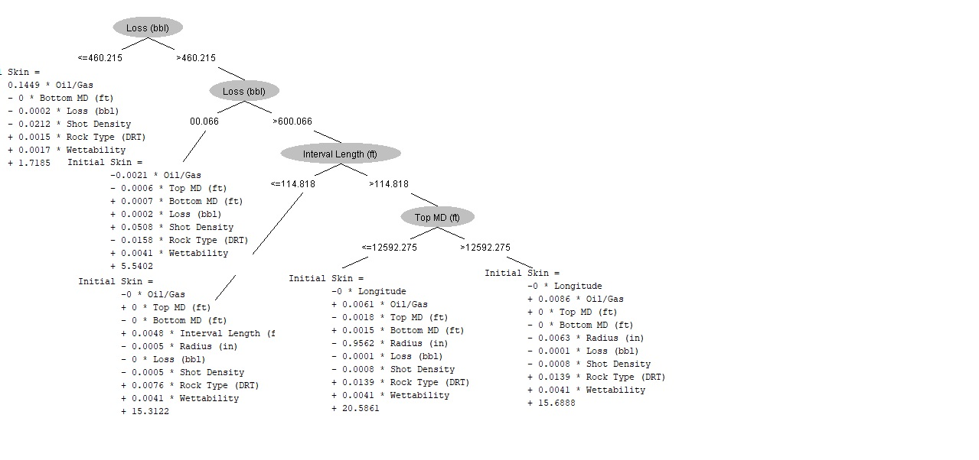
Label: Initial Skin

Slide 36
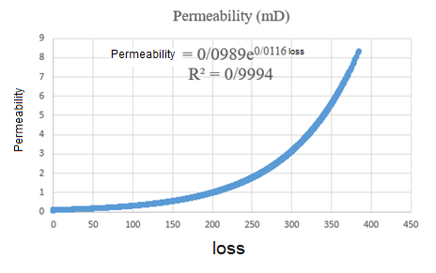
Label: Permeability

Slide 37
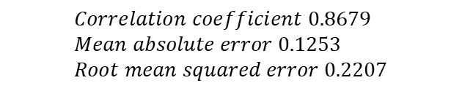
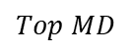
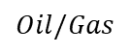
Oil/Gas
Latitude,Longtitude
$$Correlation coefficient 0.8679 \\ Mean absolute error 0.1253 \\ Root mean squared error 0.2207$$
$$Oil/Gas$$
$$Top MD$$
$$Oil/Gas =−0.0002 ∗ Top MD (ft) +2.2487$$
$$Rock Type (DRT) =3.2562 ∗ Carbonate∕Sandstone + 10.7508$$
$$Permeability (mD) = 195.2384 ∗ Rock Type (DRT) +8452.9054 ∗ Porosity +−3263.7614$$
$$Fracture Pressure (psi) = 0.6878 ∗ Bottom MD (ft)− 0$$

